Slide 1
Mathematical Foundation of Machine Learning
VIII. Reinforcement Learning 3

Slide 2
Outline
Introduction
Black-box model based RL
White-box model based RL
ref: http://rail.eecs.berkeley.edu/deeprlcourse/

Slide 3
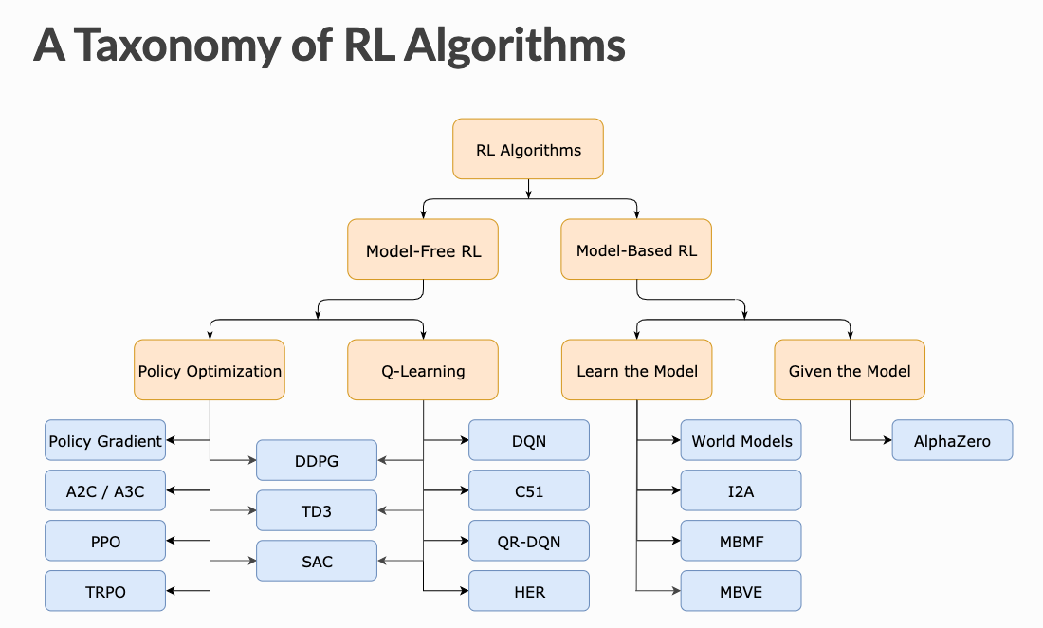

Slide 4
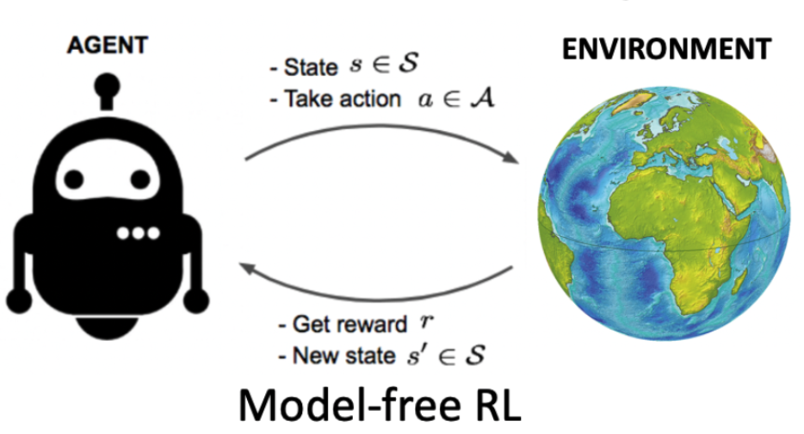
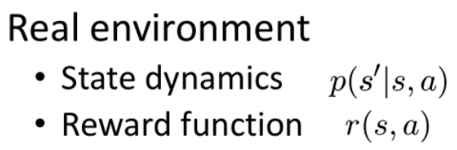
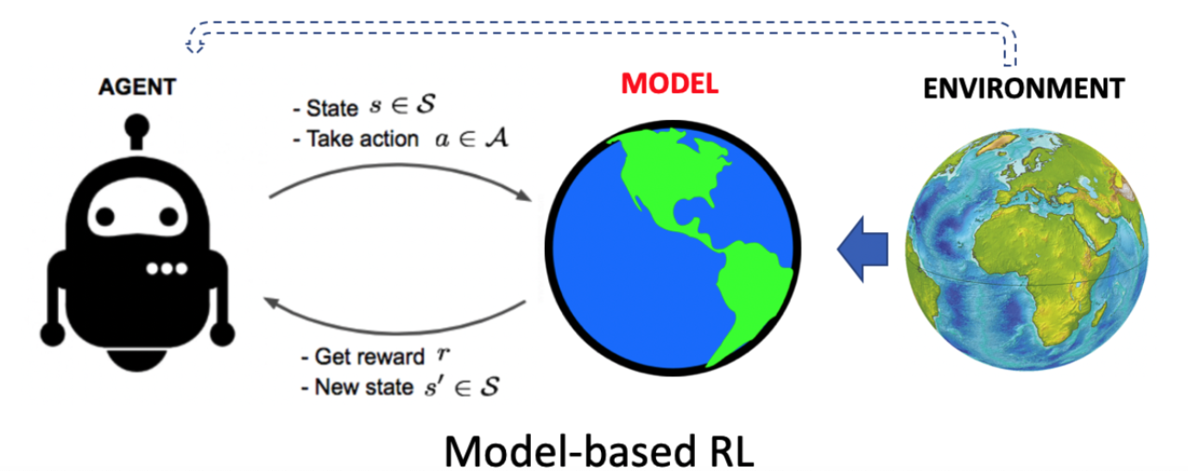
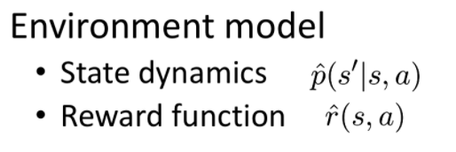

Slide 5
Model-free RL | Model-based RL
off-policy methods still show instabilities | on-policy once the model is learned
highly suitable for DL architecture with big data | May not need further real interaction data once the model is learned
very low sample efficiency and require huge amount of training data | always show higher sample efficiency than MFRL
Best asymptotic performance | Suffer from model compounding error

Slide 6
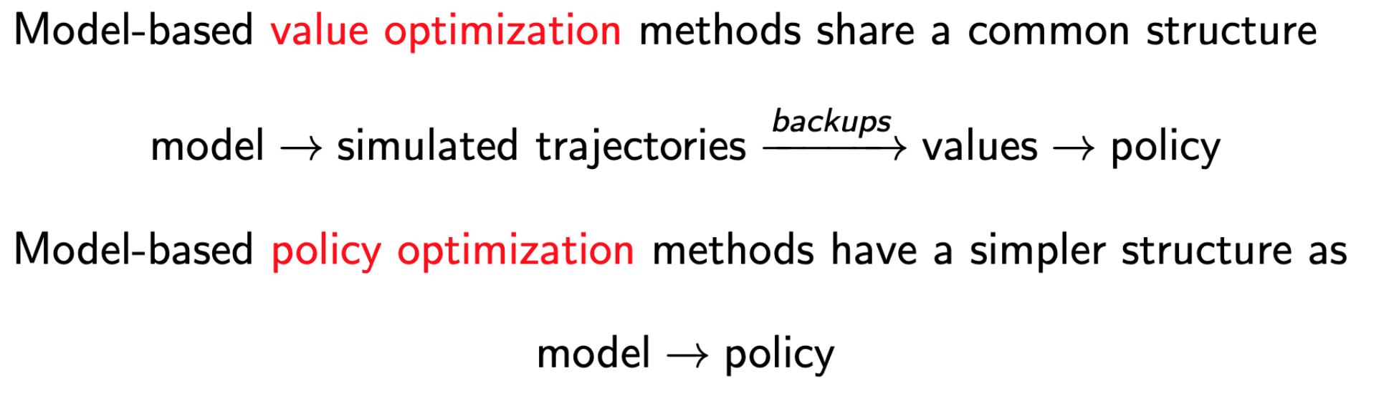
Black-box vs. White-box

Slide 7
Key questions of Model-based RL:
1. Does the model really help improve the data efficientcy?
2. Inevitably, the model is to some extent inaccurate, when to trust the model?
3. How to properly leverage the odel to better train our policy?

Slide 8
Q-learning vs Dyna-Q

Slide 9
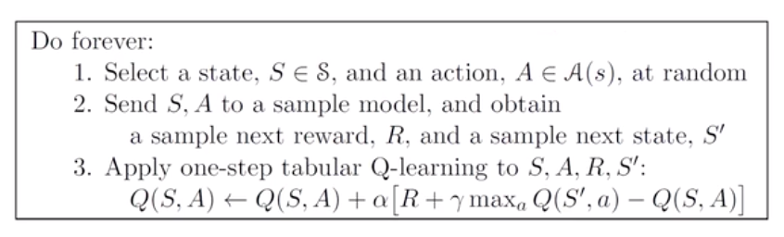
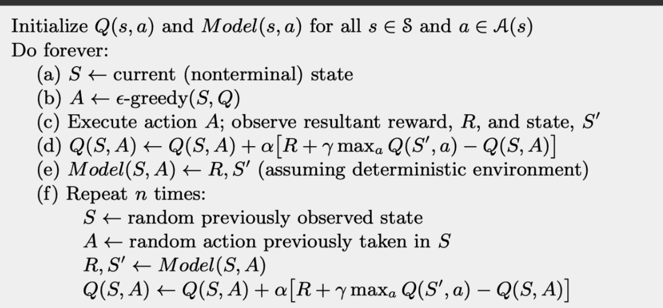
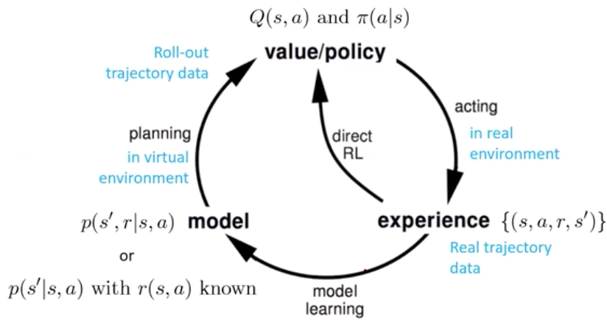
Q-planning
Dyna-Q (Sutton NIPs 2009)
Q-planning
Note：one 1-step model-free，n 1-steps model-based（Q-planning）

Slide 10
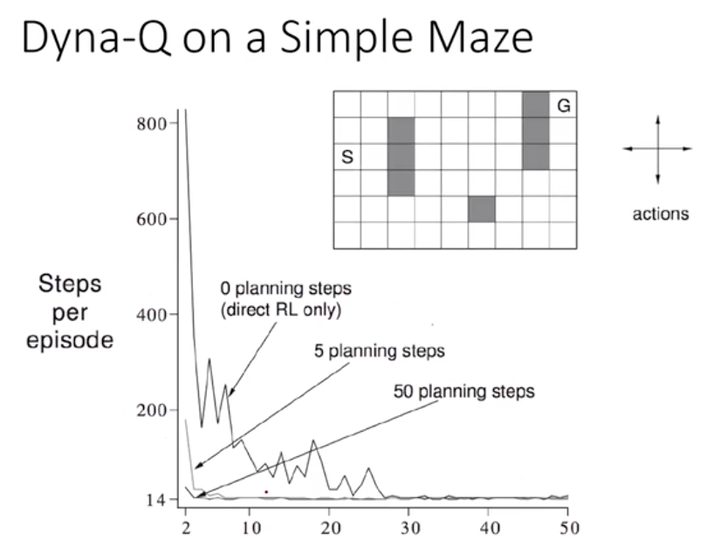

Slide 11
How to get a good dynamic model f(s, a) ?

Slide 12
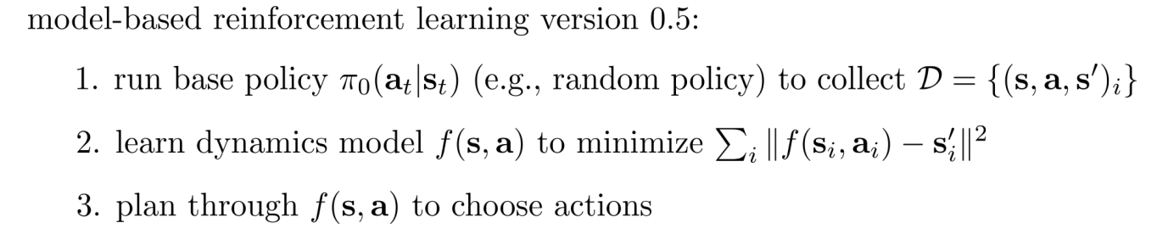
MBRL framework
But transition dynamics should change over time?

Slide 13
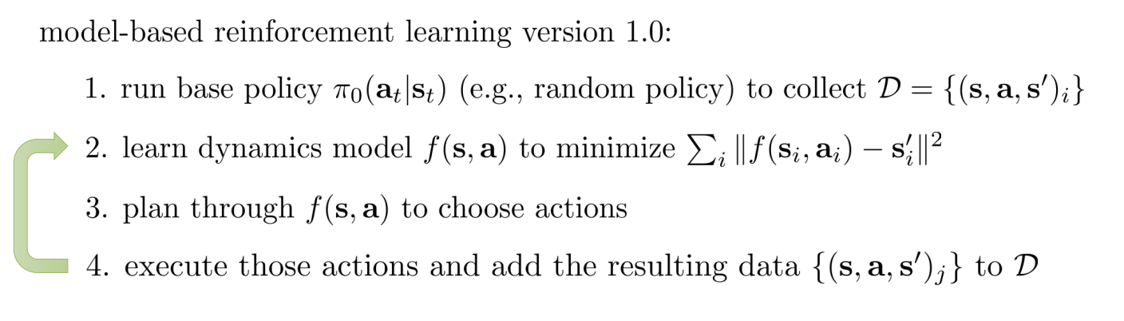
MBRL framework
May not reach sub-optimal. How to gurantee that action selected through planning (3) can have high reward?

Slide 14
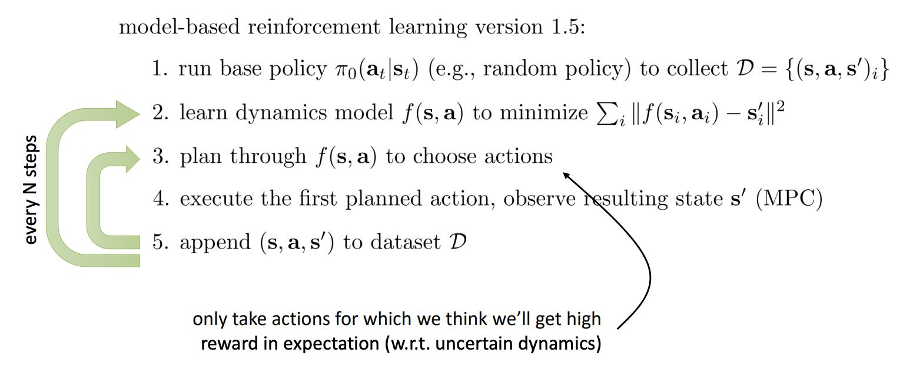
MBRL framework

Slide 15
Model predictive control：
RS -> CEM -> PETS -> POPLIN

Slide 16
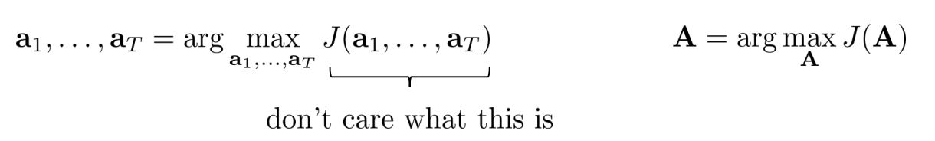
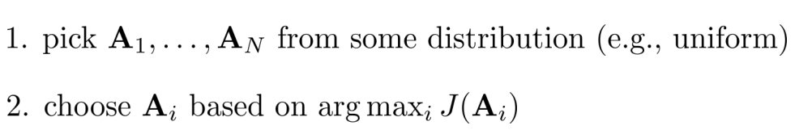
Shooting methods - random shooting
Abstract away optimal control/planning through stochastic optimization
prons
simple to implement and very fast if parallelized
lower computational burden (no graidents)
cons
high variance and harsh dimension limit
may not sample the high reward

Slide 17
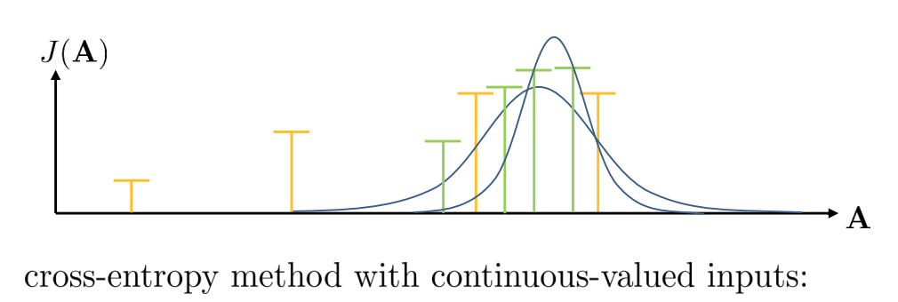
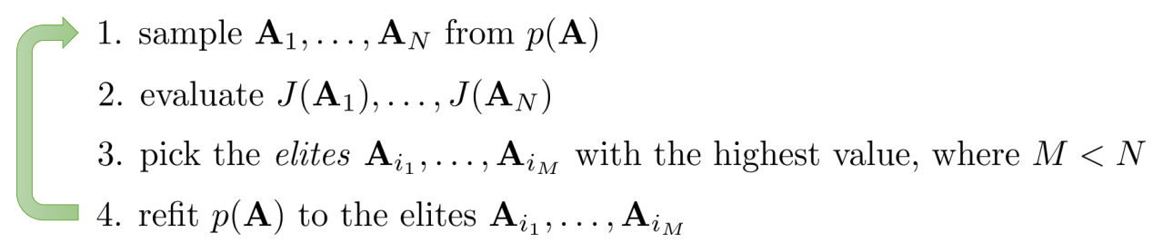
Refinement: Cross Entropy Method (CEM)
ref: The Cross Entropy method for Fast Policy Search (ICML 2003)
Tutorial from MIT
The Cross-entropy Method for Optimization （2013）

Slide 18
Refinement: Cross Entropy Method (CEM)
ref: The Cross Entropy method for Fast Policy Search (ICML 2003)
Tutorial from MIT
Note:
1. can be either continuous or discrete actions depends on the probability setting
2. see also: CMA-ES (sort of like CEM with momentum)

Slide 19
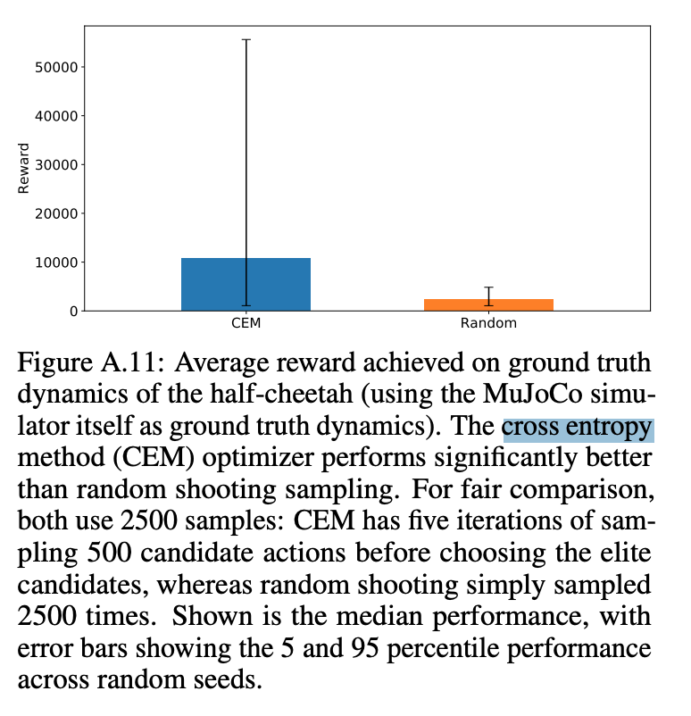
Random shooting vs. CEM
Deep Reinforcement Learning in a Handful of Trials using Probabilistic Dynamics Models NIPs 2018

Slide 20
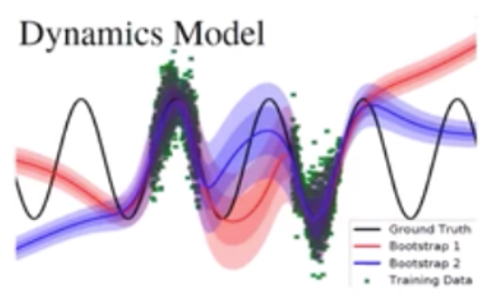
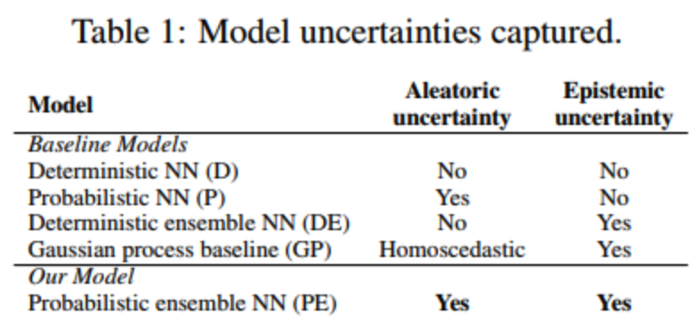
PETs: Probabilistic Ensembles with Trajectory sampling
Model-based approaches enjoys 1) sample efficiency (meaning they learn quickly), 2) and a reward-independent dynamics model (thinking of model-free approaches require the reward function to update), but meanwhile lagging behind model-free approaches in asymptotic performance (meaning they converge to sub-optimal solutions).
GP is efficient but lacks expressiveness, deterministic NN used in many prior works suffer from overfitting in the ealy stages of learning.
Goal: challenge in model-based RL - perform well in both low and high data regimes.
Two uncertainties:
Epistemic Uncertainty (Systematiac system) - Our subjective uncertainty due to a lack of data (model variance)
Aleatoric Uncertainty (Statistical uncertainty) - Each probabilistic nueral network captures stochastic environment.
Deep Reinforcement Learning in a Handful of Trials using Probabilistic Dynamics Models NIPs 2018

Slide 21
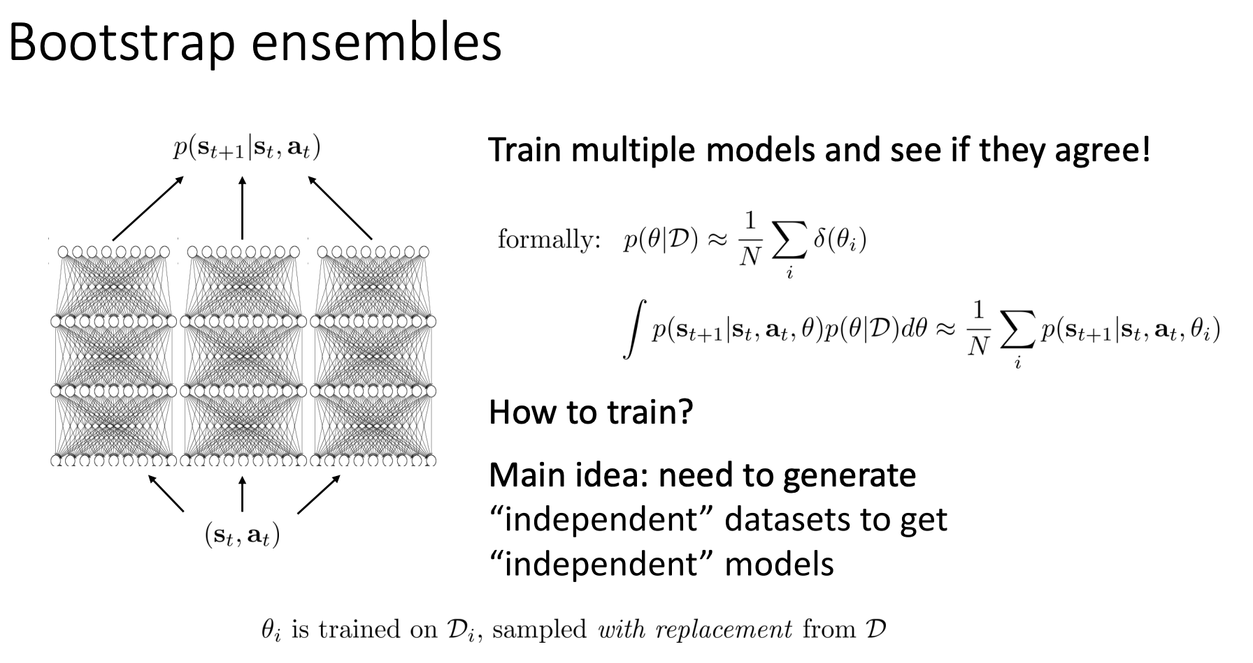

Slide 22
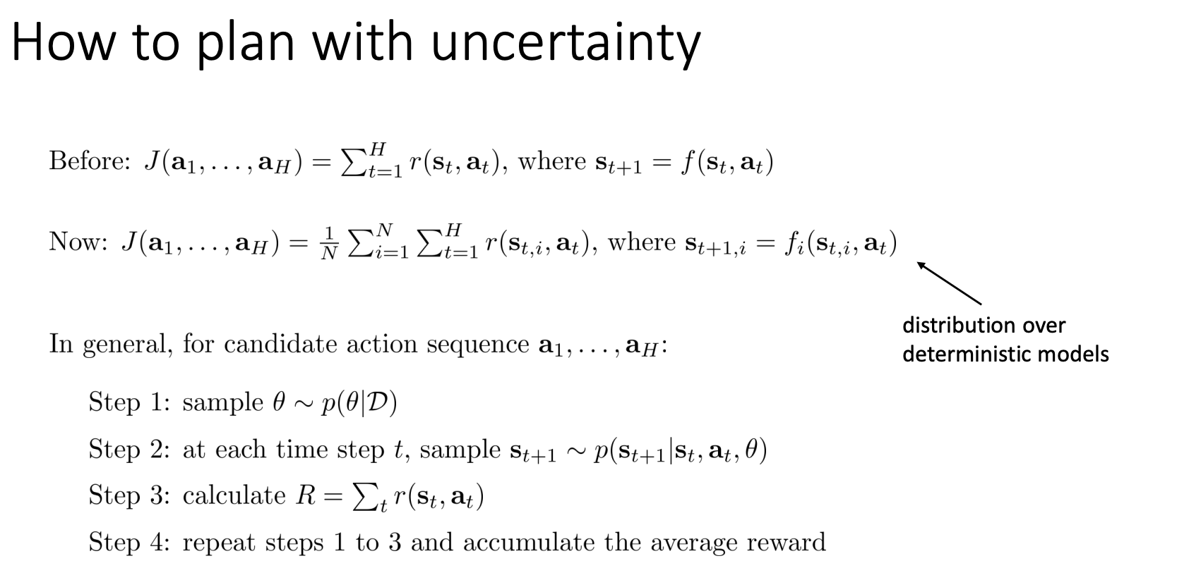

Slide 23
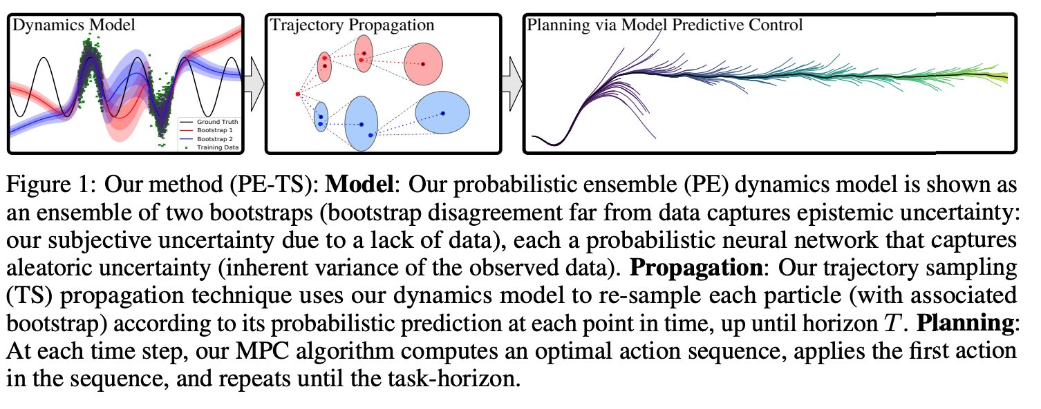
PETs: Probabilistic Ensembles with Trajectory sampling
Gaussian NN
Ensemble

Slide 24
PETs: Probabilistic Ensembles with Trajectory sampling
Trajectory sampling(TS) propagation: uses dynamical model to re-sample each particle according to its probabilistic prediction at each time point, up until horizon T.

Slide 25
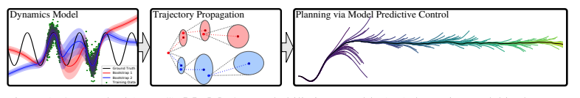
PETs: Probabilistic Ensembles with Trajectory sampling
Planning: at each time step, MPC algorithm helps us to get action sequence which has high evvironment. Apply the first action in the sequence and repeats until task horizon.

Slide 26
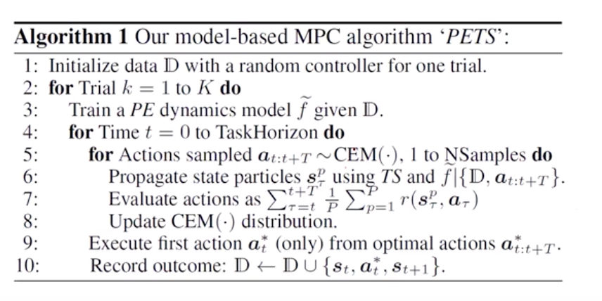
PETs: Probabilistic Ensembles with Trajectory sampling

Slide 27
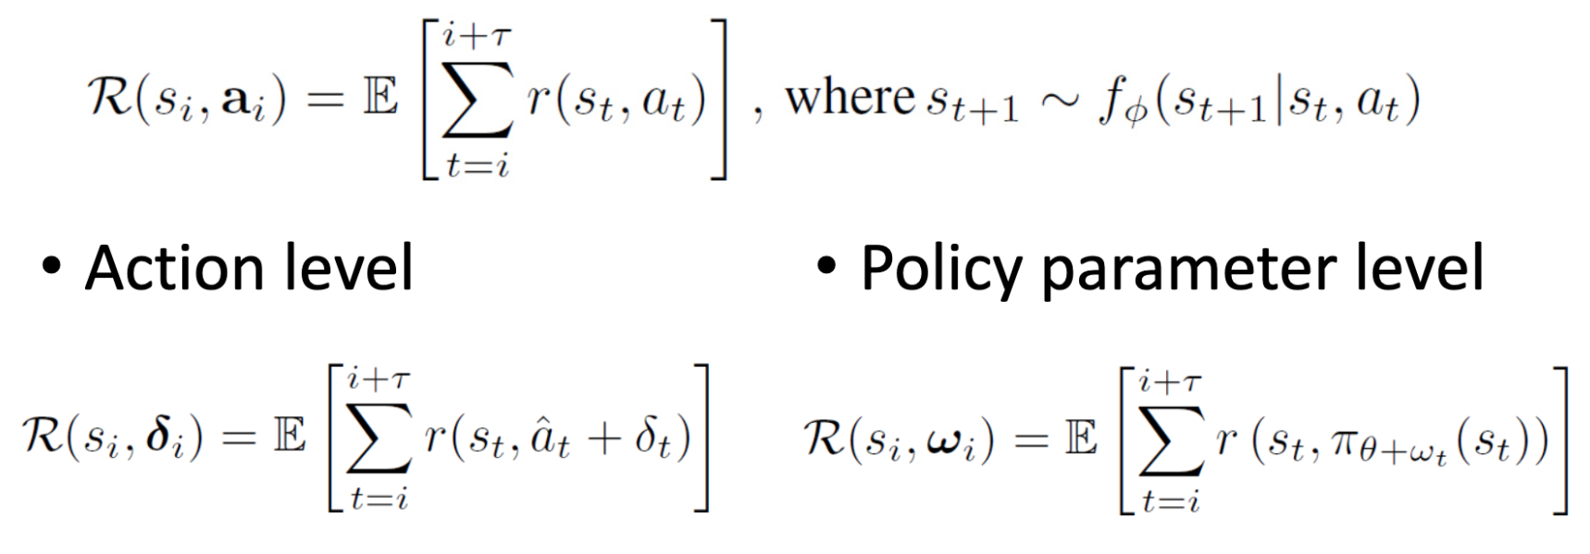
POPLIN: Exploring Model-based Planning with Policy Networks (2019)
PETs uses CEM to maintain a distribution of actions yielding high reward at each time step
Good robustness and stability
But still low sample efficiency
Not easy to scale to high-dimensional, complex dynamical systems (environments).
POPLIN: maintain a policy to sample actions given the current simulated state.

Slide 28
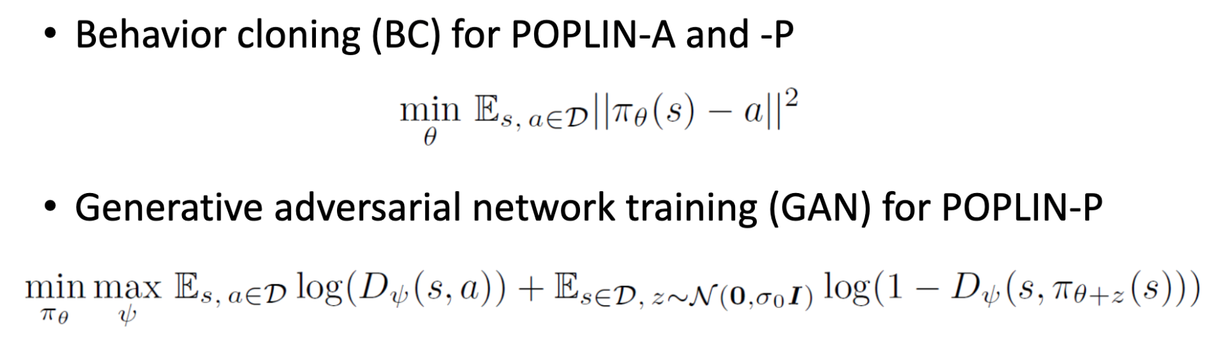
How to best utilize {(s,a)} pairs after planning, where a is the "best" action based on current simulated state?
https://github.com/WilsonWangTHU/POPLIN

Slide 29
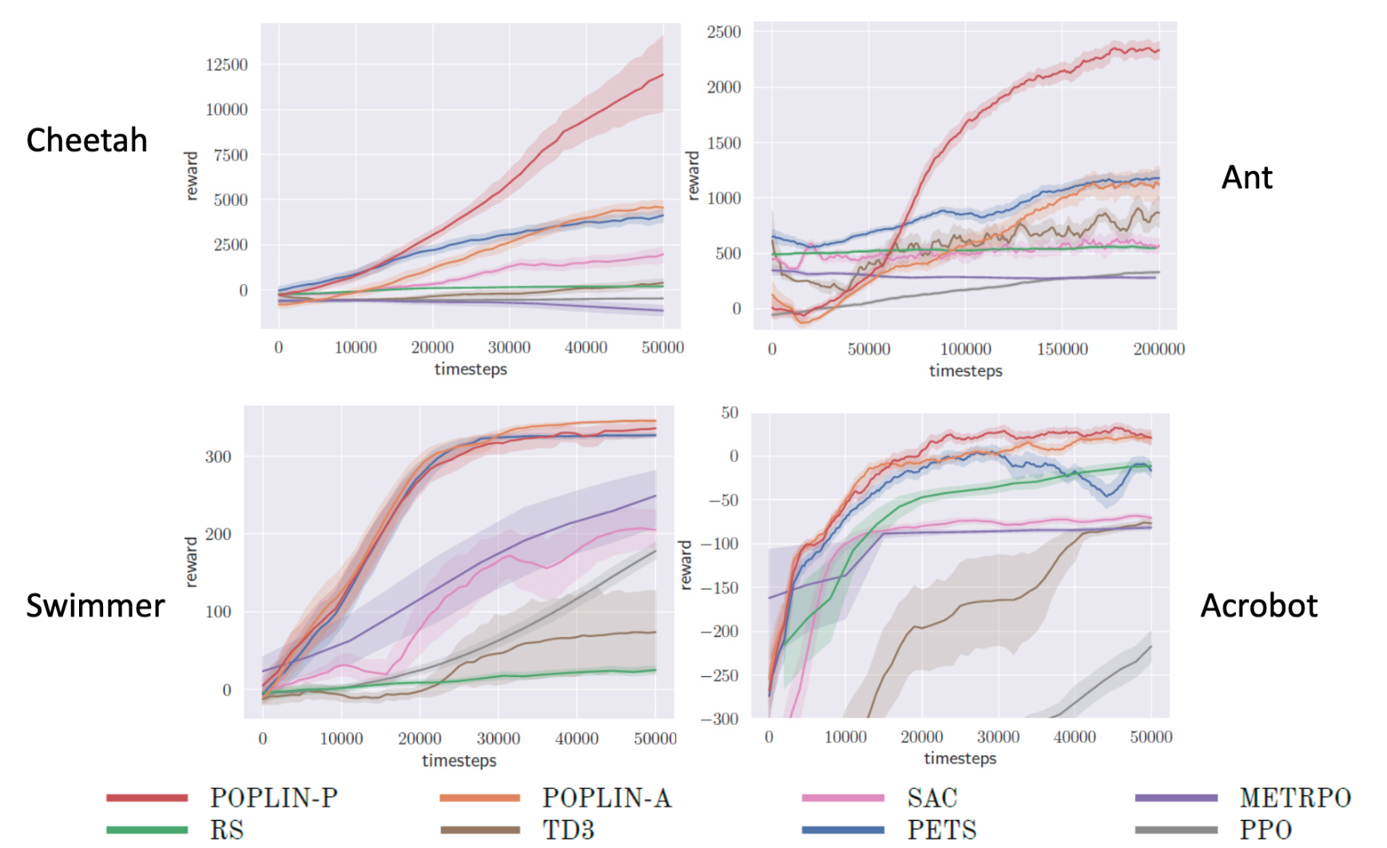

Slide 30
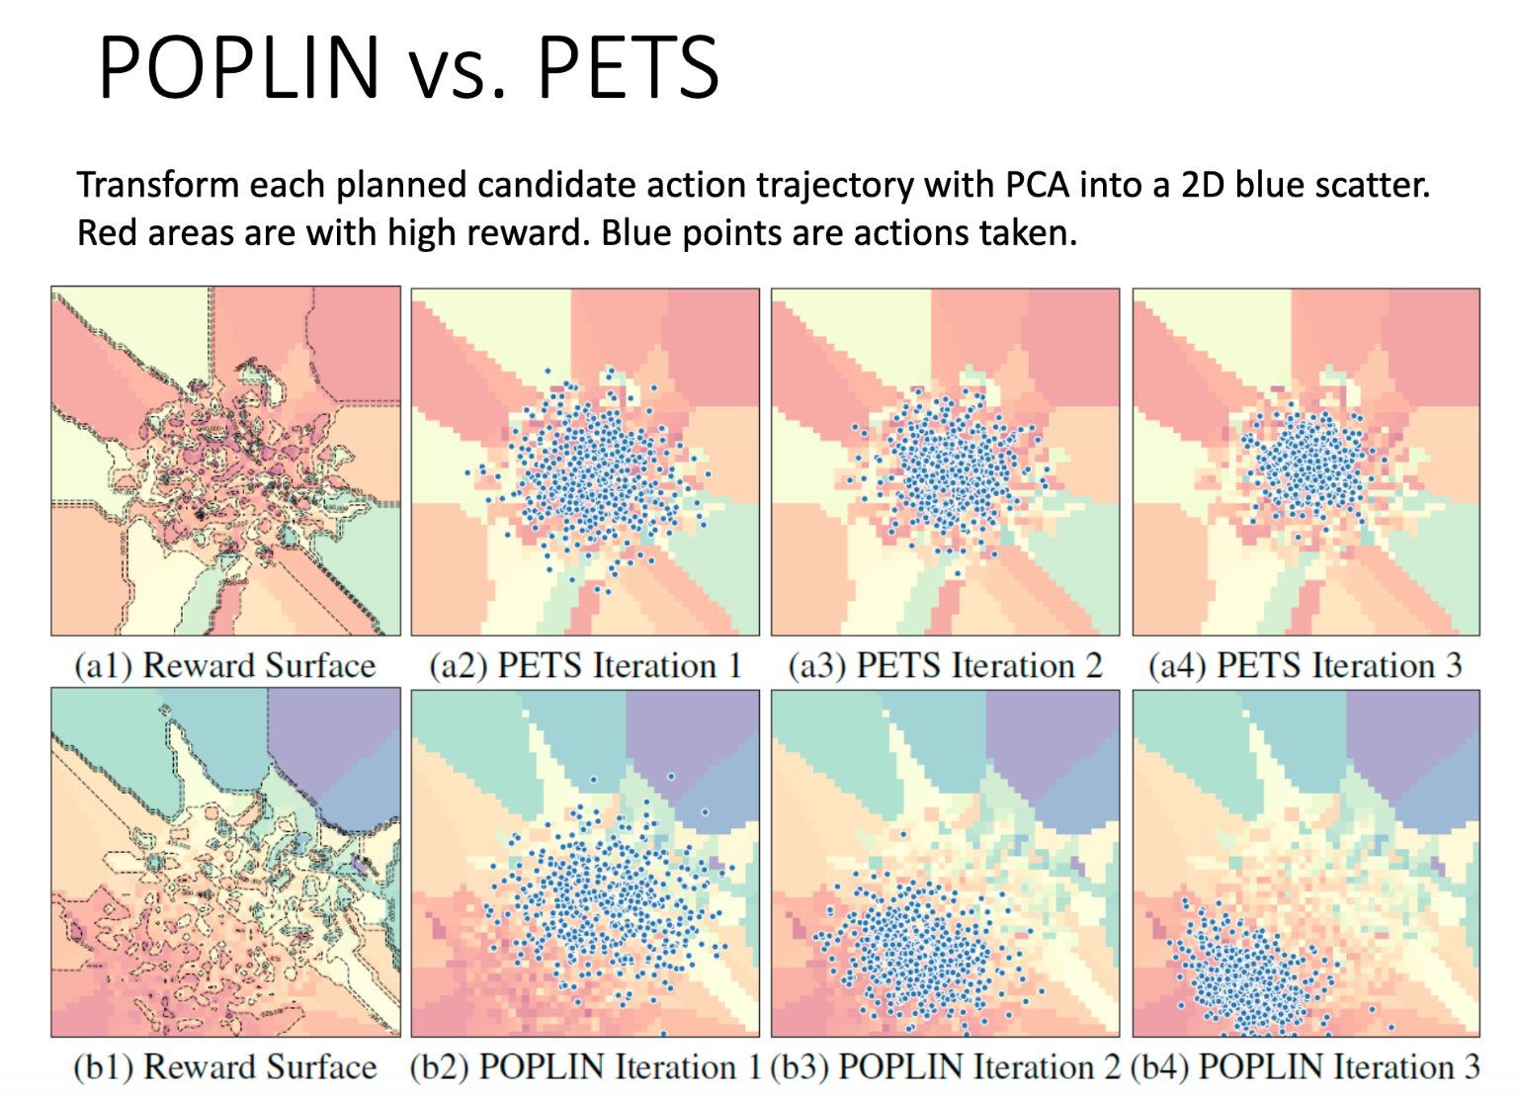

Slide 31
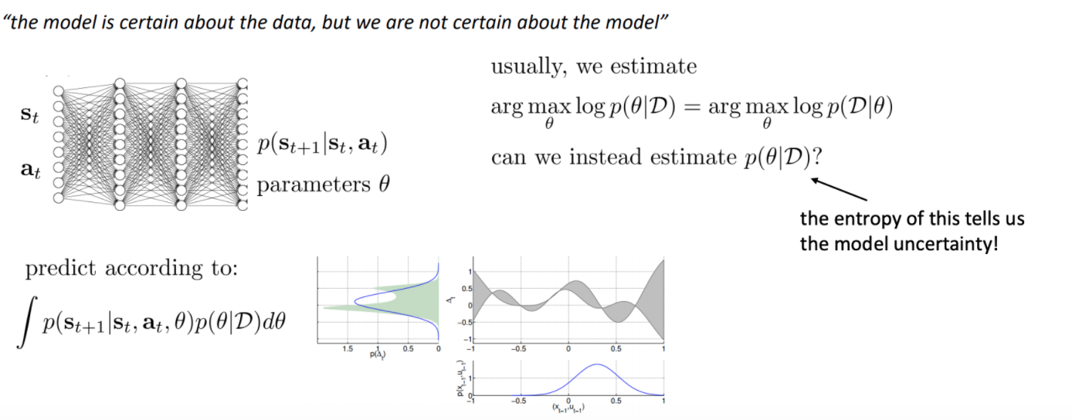
Research directions:
1. Learning new appropriate probability distributions

Slide 32
Research directions:
1. Learning new appropriate probability distributions
2. Immitation learning : POPLIN

Slide 33
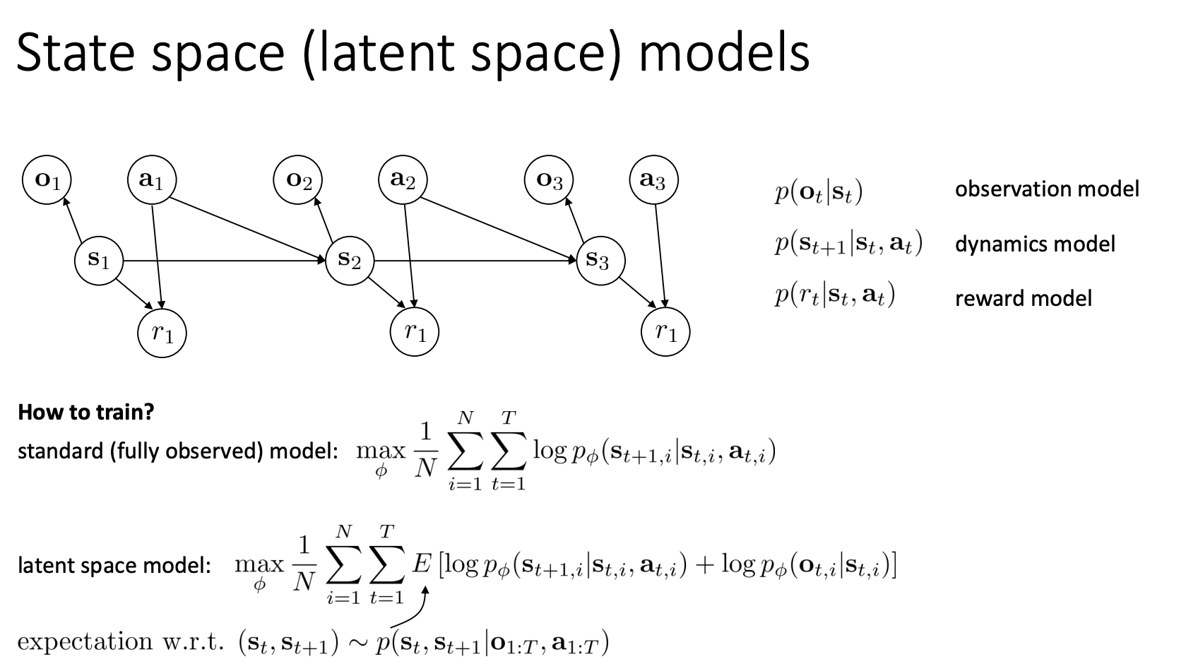
Research directions:
1. Learning new appropriate probability distributions
2. Immitation learning
3. Complex obeservations from environment

Slide 34
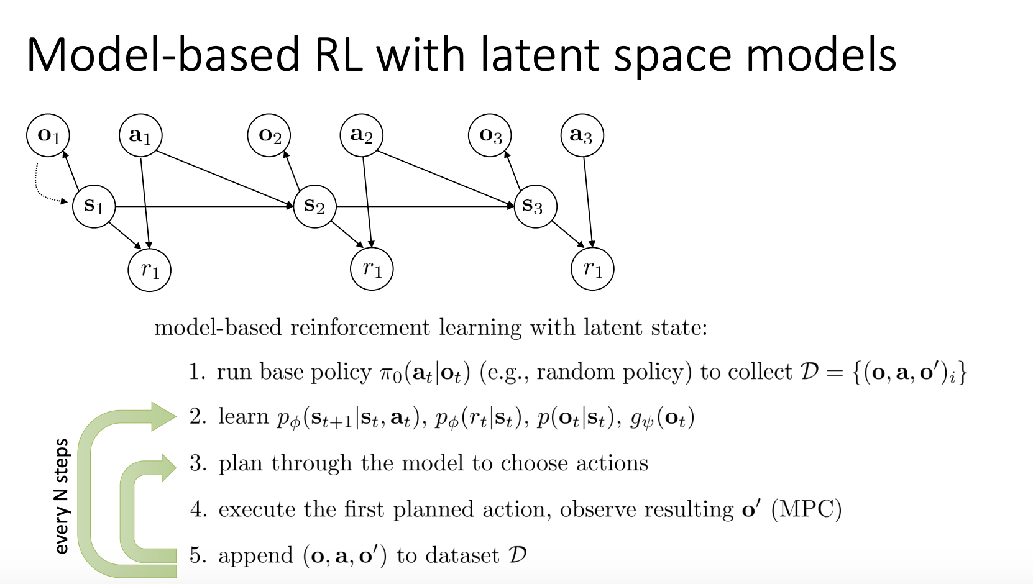
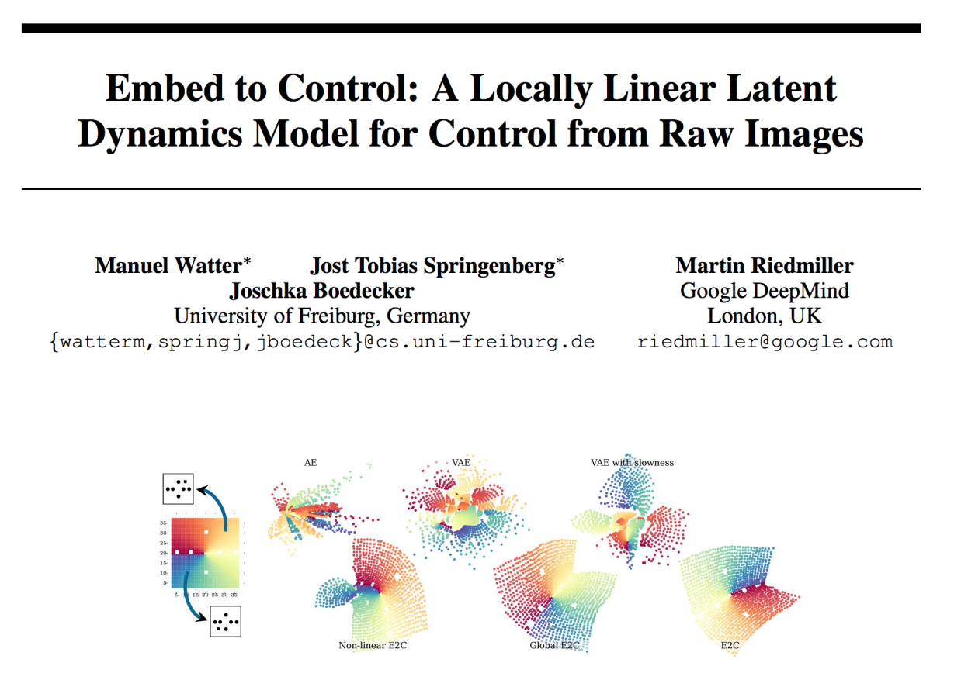
Research directions:
1. Learning new appropriate probability distributions
2. Immitation learning
3. Complex obeservations from environment

Slide 35
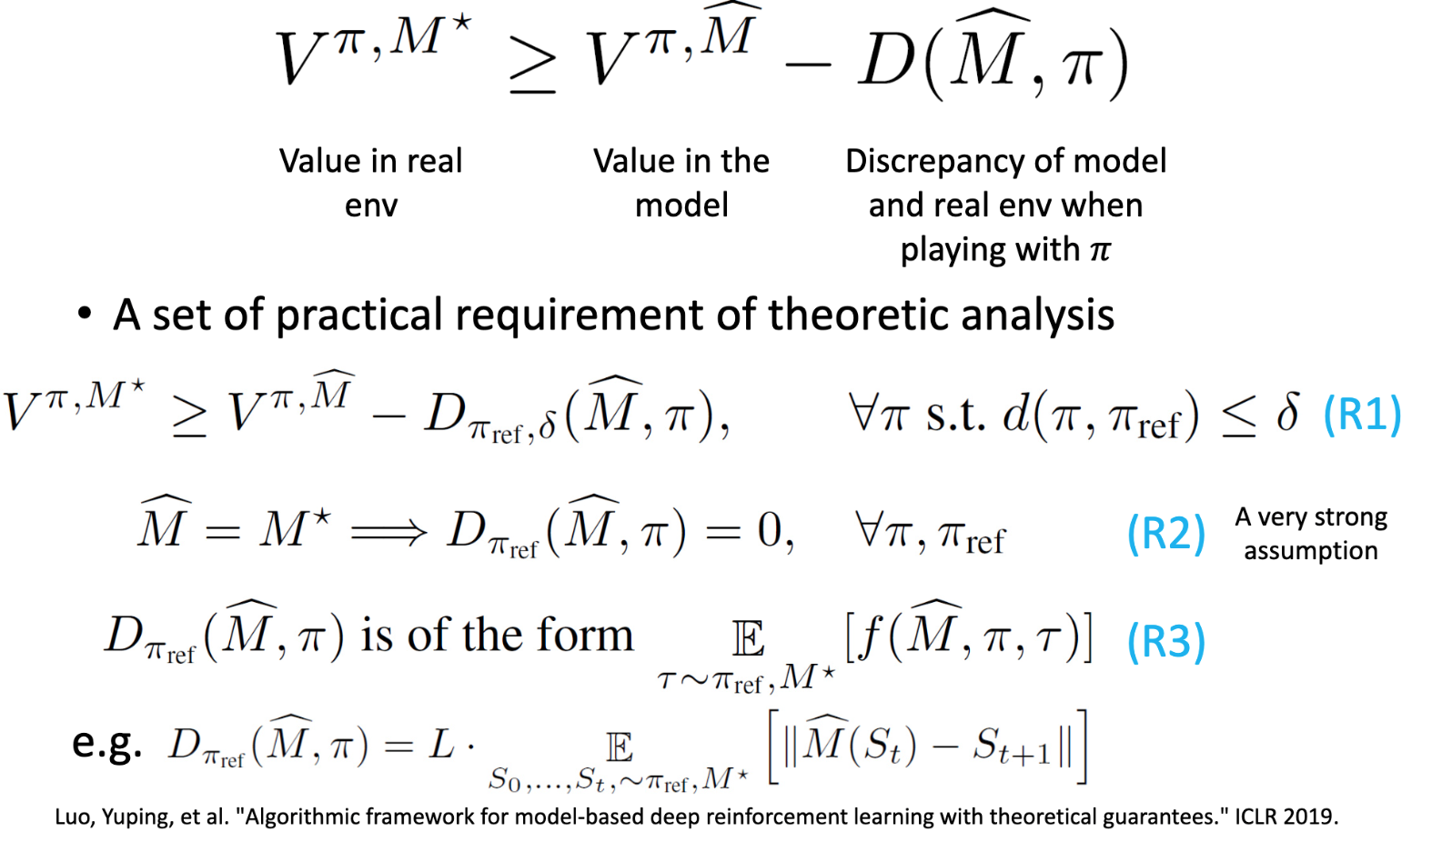
Research directions:
1. Learning new appropriate probability distributions
2. Immitation learning
3. Complex obeservations from environment
4. Better understanding of bounds for model usage

Slide 36
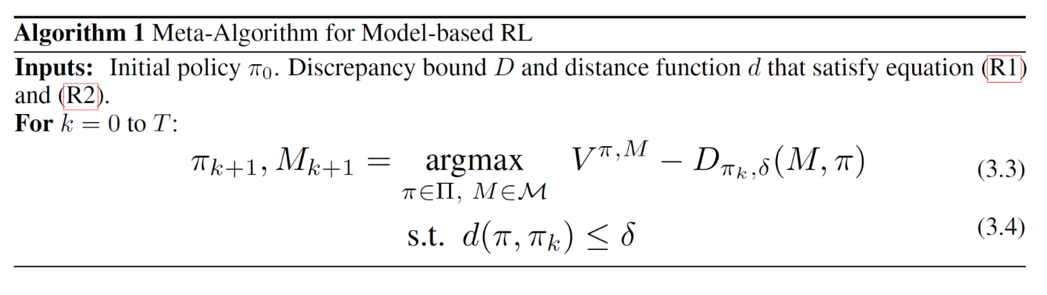
Research directions:
1. Learning new appropriate probability distributions
2. Immitation learning
3. Complex obeservations from environment
4. Better understanding of bounds for model usage
ref: SLBO: stochastic lower bound optimization
cons: long horizon, use whole rollout trajectories from the start state, model compounding errror

Slide 37
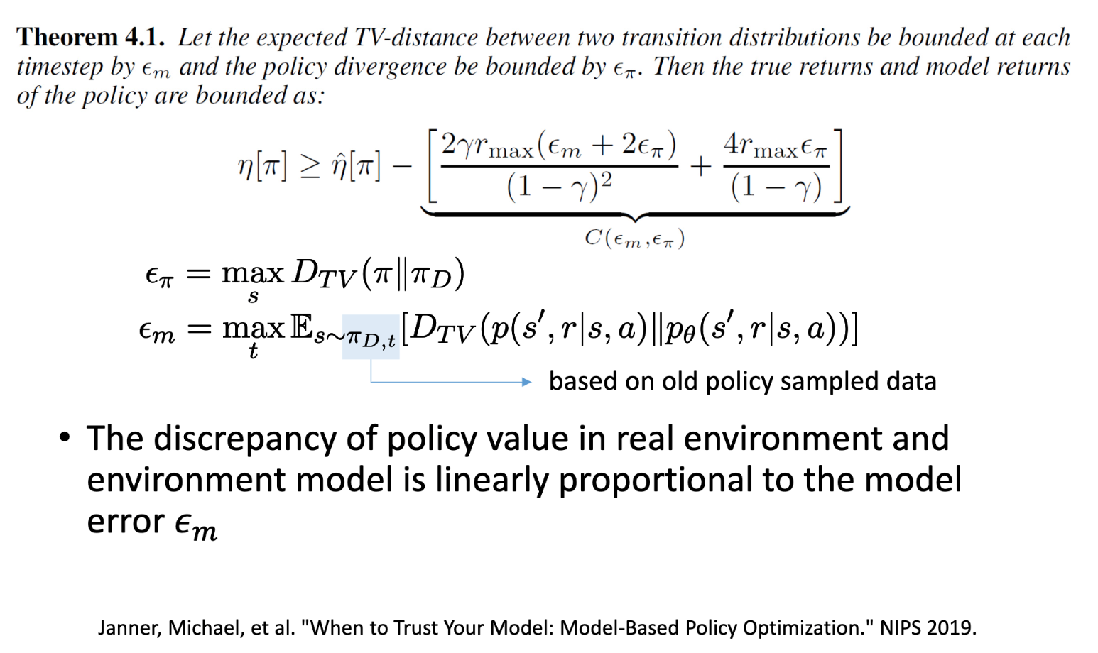
Research directions:
1. Learning new appropriate probability distributions
2. Immitation learning
3. Complex obeservations from environment
4. Better understanding of bounds for model usage

Slide 38
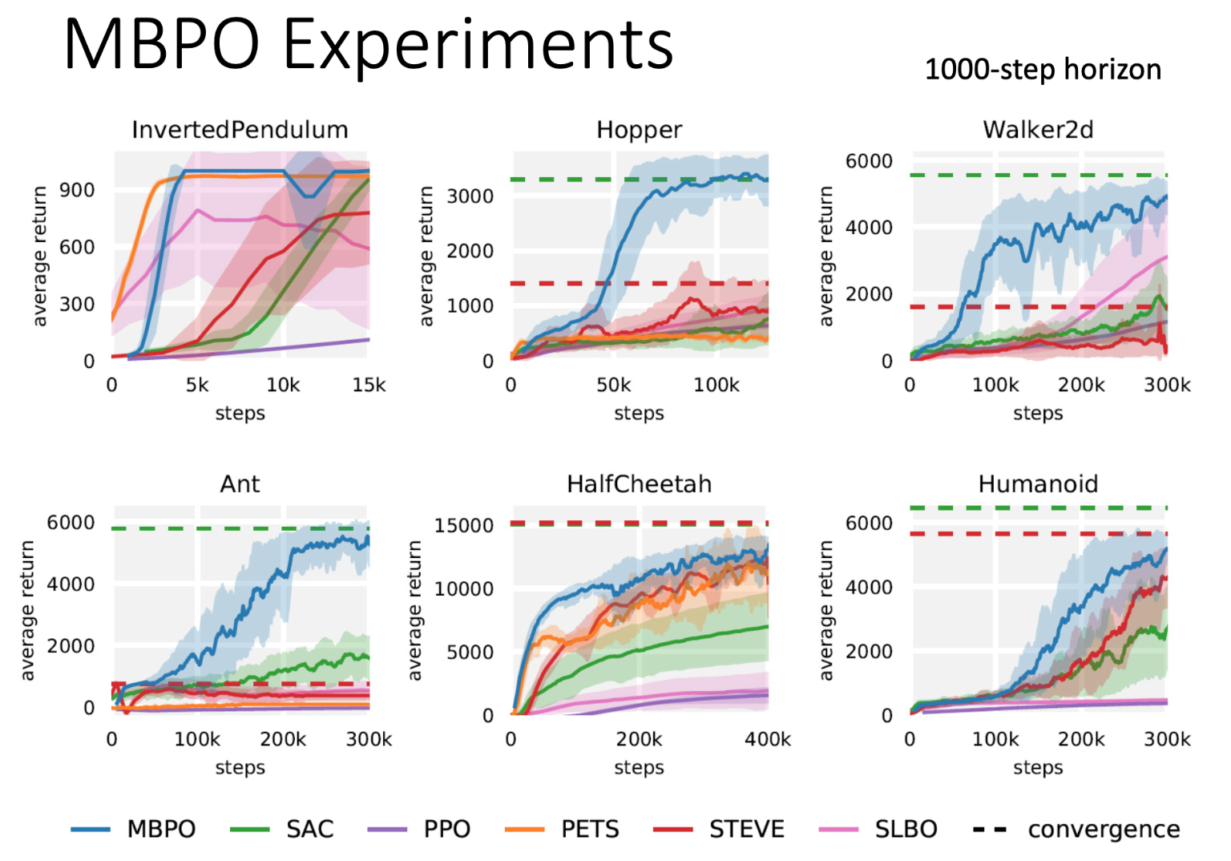
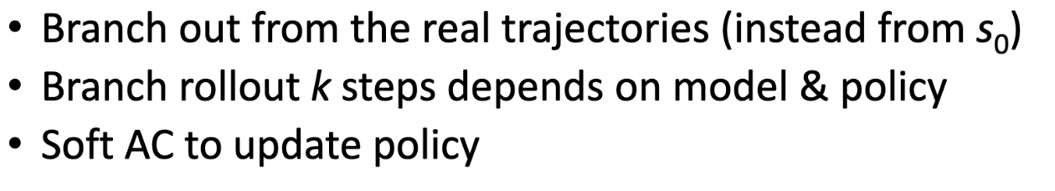
Research directions:
1. Learning new appropriate probability distributions
2. Immitation learning
3. Complex obeservations from environment
4. Better understanding of bounds for model usage
ref: MBPO: model based policy optimization

Slide 39
What we have now for white-box model-based RL:
1. Dyna-Q
2. Shooting: random shooting, cross-entropy method, PETs
3. Immitation learning: POPLIN
4. Complex observation: Latent space model
5. Theretical bound based: MBPO

Slide 40
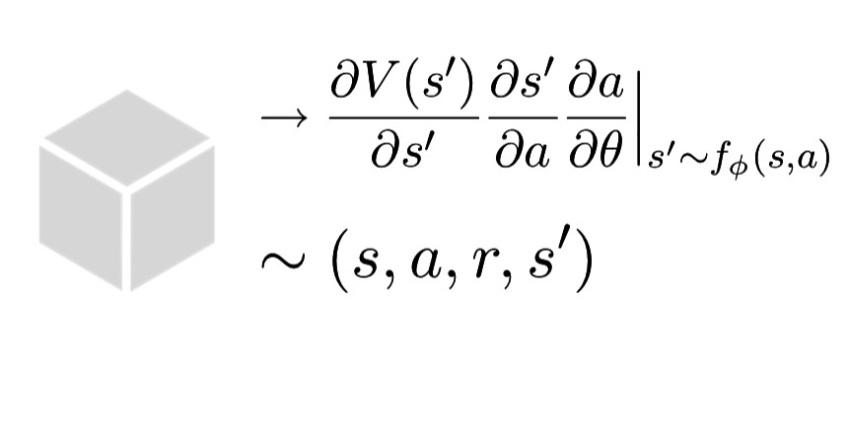
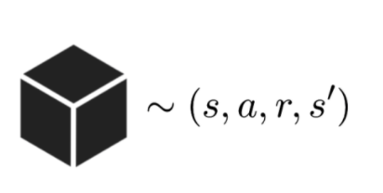
Model-based RL
Done:
NEXT:
Blackbox model
Seamless to policy training algorithms
Simulation data efficiency still low
e.g. Dyna-Q, MPC, MBPO
Whitebox model
Offer both data and gradient guidance for value and policy
High data efficiency
e.g. MAAC, SVG, PILCO

Slide 41
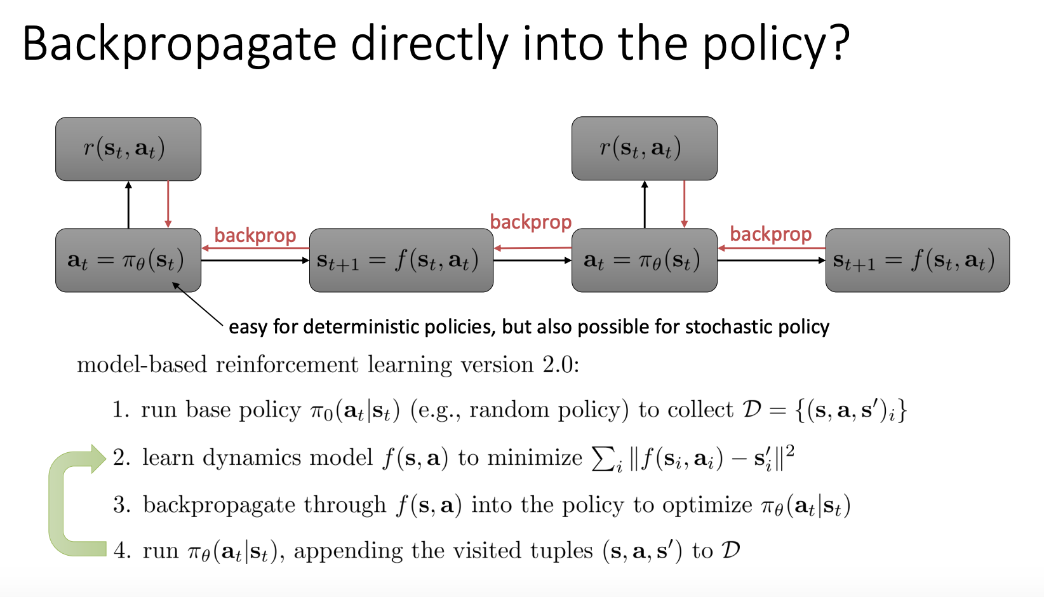
Pathwise derivative

Slide 42
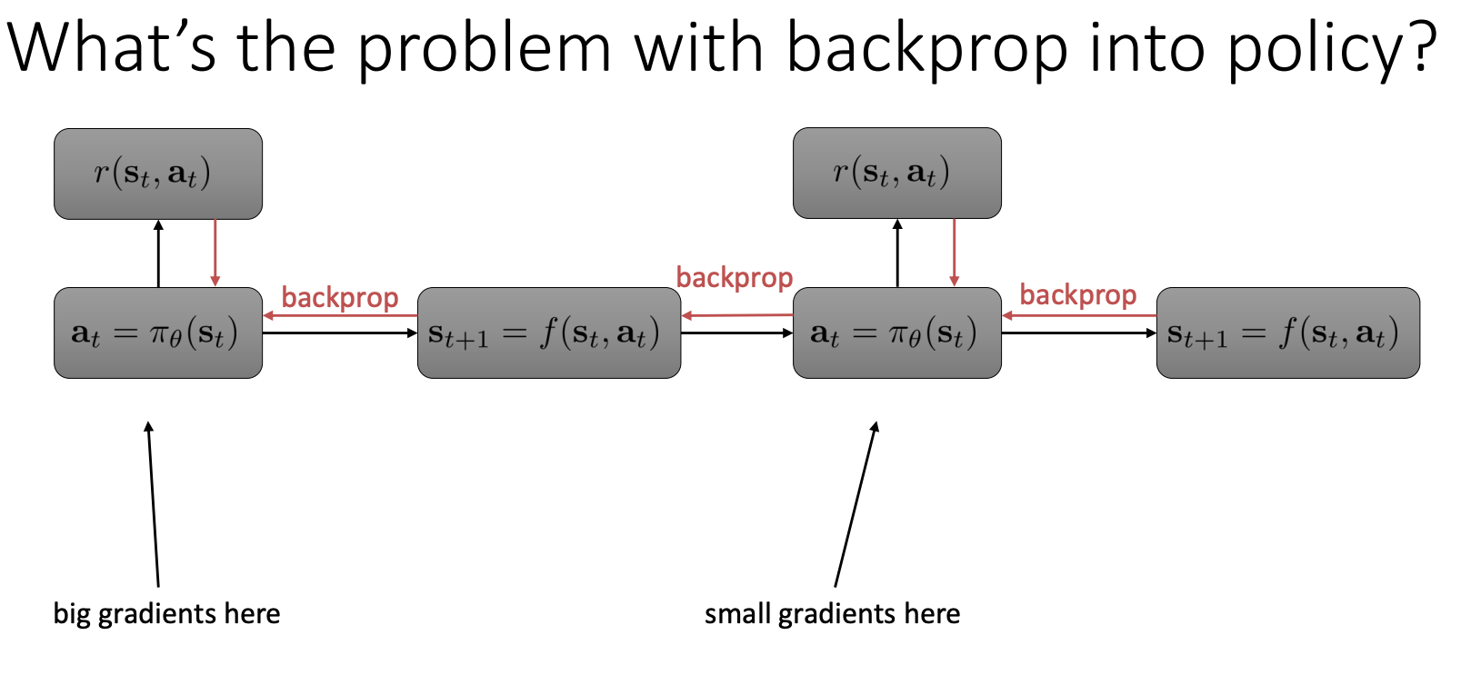

Slide 43
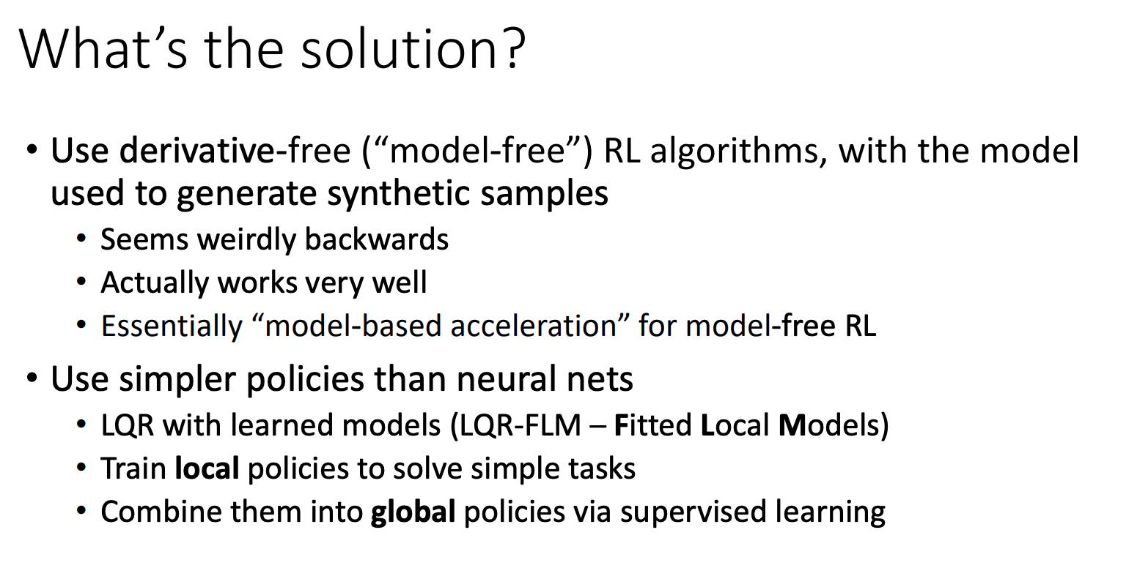

Slide 44
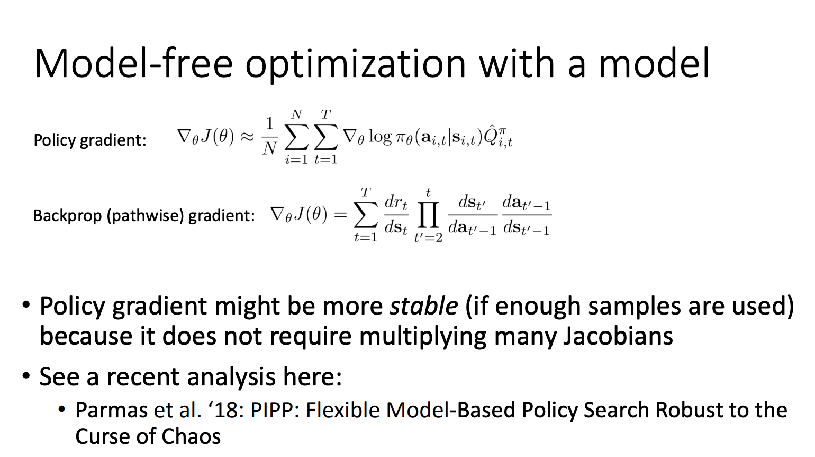

Slide 45
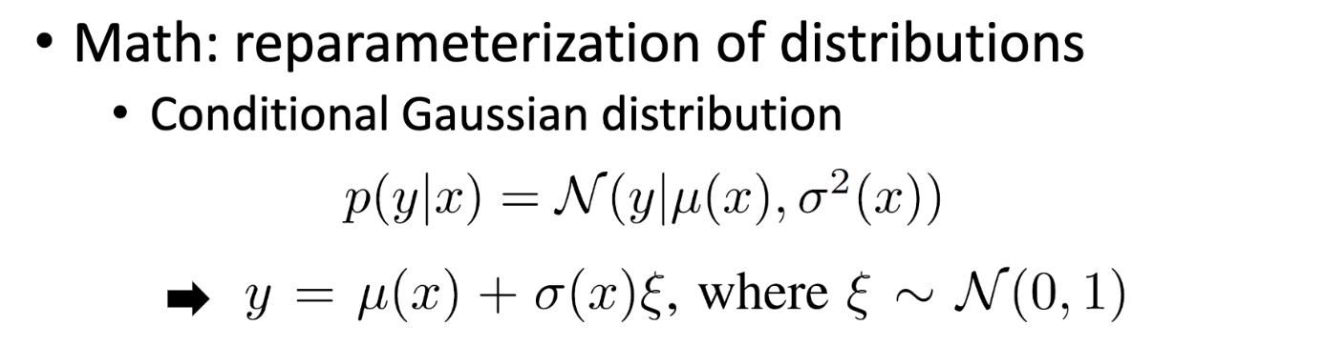
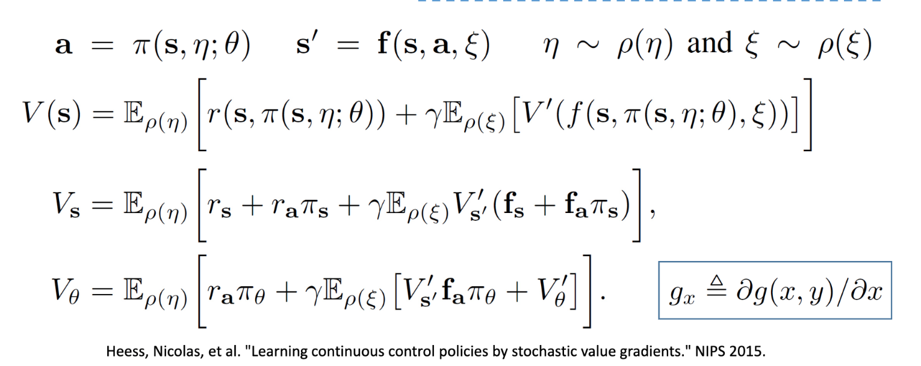
SVG algorithm
Main idea:
stochastic environment, policy, value and gradients:

Slide 46
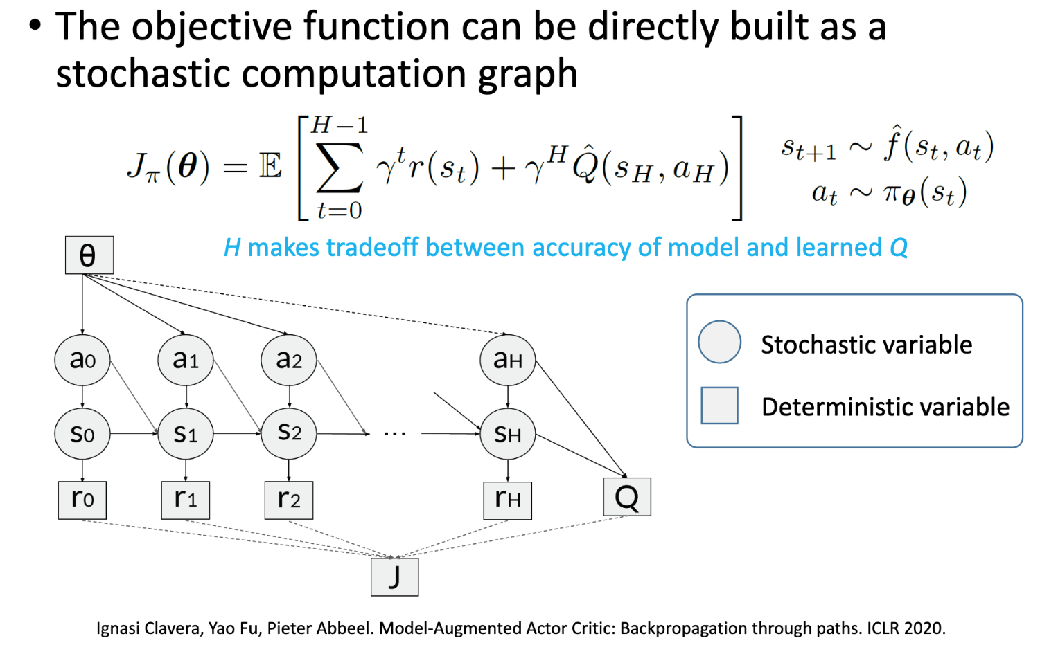
MAAC: Model augumented Actor-critic

Slide 47
